Slide 1
Chapter 4:
Loops and Files
Starting Out with Java:
From Control Structures through Objects
Second Edition
by Tony Gaddis
Notes:
CHAPTER 4
Java Gaddis 4e

Slide 2
Chapter Topics
Chapter 4 discusses the following main topics:
  The Increment and Decrement Operators
  The while Loop
  Using the while Loop for Input Validation
  The do-while Loop
  The for Loop
  Running Totals and Sentinel Values
4-<number>
Notes:
CHAPTER 4
Java Gaddis 4e

Slide 3
Chapter Topics
Chapter 4 discusses the following main topics:
  Nested Loops
  The break and continue Statements
  Deciding Which Loop to Use
  Introduction to File Input and Output
  The Random class
4-<number>
Notes:
CHAPTER 4
Java Gaddis 4e

Slide 4
INCREMENT and DECREMENT OPERATORS
count = count + 1;
count += 1;
This can be written as: count++;
index = index – 1;
index -= 1;
This can be written as: index--;
The increment (++) and decrement (--) operators add/subtract one from a variable
Notes:
Java Gaddis 4e
CHAPTER 4

Slide 5
INCREMENT and DECREMENT OPERATORS
It gets more complicated: There are two ways to use ++ and --
pre-increment: ++ before the variable
int b, x = 3;
b = ++x; // pre-increment
First: add 1 to x
Then: assign new x to b
Result: x ← 4 and then b ← 4
Notes:
Java Gaddis 4e
CHAPTER 4

Slide 6
INCREMENT and DECREMENT OPERATORS
There are two ways to use ++ and --
post-increment
int b, x = 3;
b = x++; // post-increment
First: assign x's value to b
Then: add 1 to x
Result: b ← 3 and then x ← 4
Notes:
Java Gaddis 4e
CHAPTER 4

Slide 7
INCREMENT and DECREMENT OPERATORS
Exercises
What is the output?
int a = 5;
System.out.println(++a);
System.out.println(a);
Notes:
Java Gaddis 4e
CHAPTER 4

Slide 8
INCREMENT and DECREMENT OPERATORS
Exercises
What is the output?
int a = 5;
System.out.println(++a); // outputs 6
System.out.println(a); // outputs 6
How?
  Pre-increment, so FIRST add 1 to a.
  Then display a's value, which is now 6.
Notes:
Java Gaddis 4e
CHAPTER 4

Slide 9
INCREMENT and DECREMENT OPERATORS
Exercises
What is the output?
int b = 2;
System.out.println(b--);
System.out.println(b);
Notes:
Java Gaddis 4e
CHAPTER 4

Slide 10
INCREMENT and DECREMENT OPERATORS
Exercises
What is the output?
int b = 2;
System.out.println(b--); // outputs 2
System.out.println(b); // outputs 1
How?
  Post-decrement, so FIRST display b's value, which is 2.
  Then take 1 away from b, which is now 1.
Notes:
Java Gaddis 4e
CHAPTER 4

Slide 11
INCREMENT and DECREMENT OPERATORS
More Exercises:
int a = 8, b = 2, c;
c = ++a;
c = b--;
c = ++b – a;
c = b++ – a;
Notes:
Java Gaddis 4e
CHAPTER 4

Slide 12
INCREMENT and DECREMENT OPERATORS
More Exercises:
int a = 8, b = 2, c;
c = ++a; // a ← 9, then c ← 9
c = b--; // c ← 2, then b ← 1
c = ++b – a; // b ← 3, then
// c ← 3 – 8 or -5
c = b++ – a; // c ← 2 – 8 or -6, then
// b ← 3
Notes:
Java Gaddis 4e
CHAPTER 4

Slide 13
INCREMENT and DECREMENT OPERATORS
Exercises
Fill in the blanks
int a = 9, b = 20, c;
c = --a;
c is ______ a is ______
c = b++;
c is ______ b is ______
Notes:
Java Gaddis 4e
CHAPTER 4

Slide 14
INCREMENT and DECREMENT OPERATORS
Moral of the story is:
BE CAREFUL!
Exercises
Fill in the blanks
int a = 9, b = 20, c;
c = --a;
c is __8____ a is __8____
c = b++;
c is __20____ b is __21____
Notes:
Java Gaddis 4e
CHAPTER 4

Slide 15
Notes on Increment, Decrement
If you are ONLY adding 1 to a variable and have no other operators or function calls in the expression, you can use either operator!
count = count + 1;
count += 1;
This can be written as: count++; OR ++count;
index = index – 1;
index -= 1;
This can be written as: index--; OR --index;
Notes:
Java Gaddis 4e
CHAPTER 4

Slide 16
Notes on Increment, Decrement
This operator is attached only to a single variable, never to an expression.
  x = ++a; // OK: pre-increment a
  x = a – b++; // OK: post-increment b
  x = ++( a + b );
  // no, must apply ++ to
  // a variable, not an expression
Notes:
Java Gaddis 4e
CHAPTER 4

Slide 17
The while Loop
Java provides three different looping structures.
The while loop has the form:
  while(condition)
  {
    statements;
  }
While the condition is true, the statements will execute repeatedly.
The while loop is a pretest loop, which means that it will test the value of the condition prior to executing the loop.
4-<number>
Notes:
CHAPTER 4
Java Gaddis 4e

Slide 18
The while Loop
Care must be taken to set the condition to false somewhere in the loop so the loop will end.
Loops that do not end are called infinite loops.
A while loop executes 0 or more times. If the condition is false, the loop will not execute.
Example: WhileLoop.java
4-<number>
Notes:
CHAPTER 4
Java Gaddis 4e

Slide 19
The while Loop
Loop: a control structure that causes a statement or statements to repeat
General format of the while loop:
  while (expression)
  statement;
statement; can also be a block of statements enclosed in { }
1-<number>
Notes:
CHAPTER 4
Java Gaddis 4e

Slide 20
The while loop Flowchart
true
boolean
expression
statement(s)
false
4-<number>

Slide 21
while Loop – How It Works
  while (expression)
  statement;
expression is evaluated
  if true, then statement is executed, and expression is evaluated again
  if false, then the the loop is finished and program statements following statement execute
Example: WhileLoop.java
1-<number>
Notes:
CHAPTER 4
Java Gaddis 4e

Slide 22
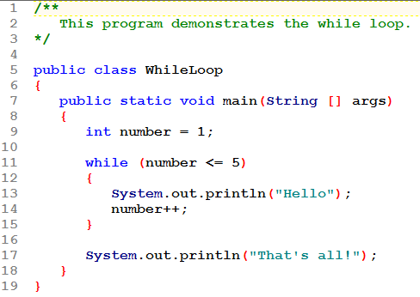
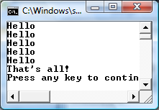

Slide 23
while is a Pretest Loop
expression is evaluated before the loop executes. The following loop will never execute:
int number = 6;
while (number <= 5)
{
System.out.println("Hello\n");
number++;
}
1-<number>

Slide 24
Infinite Loops
In order for a while loop to end, the condition must become false. The following loop will not end:
  int x = 20;
  while(x > 0)
  {
    System.out.println("x is greater than 0");
  }
The variable x never gets decremented so it will always be greater than 0.
See the fix on the next slide.
4-<number>
Notes:
CHAPTER 4
Java Gaddis 4e

Slide 25
Infinite Loops
This version of the loop decrements x during each iteration:
  int x = 20;
  while(x > 0)
  {
  System.out.println("x is greater than 0");
  x--;
  }
4-<number>
Notes:
CHAPTER 4
Java Gaddis 4e

Slide 26
Using the while Loop for
Input Validation
Here's the general approach, in pseudocode:
Not that the loop won't run if the original item of input is valid.
Read an item of input.
While the input is invalid
Display an error message.
Read the input again.
End While
1-<number>

Slide 27
The while Loop for Input Validation
  System.out.print("Enter a number in the " +
  "range of 1 through 100: ");
  number = keyboard.nextInt();
  // Validate the input.
  while (number < 1 || number > 100)
  {
  System.out.println("That number is invalid.");
  System.out.print("Enter a number in the " +
  "range of 1 through 100: ");
  number = keyboard.nextInt();
  }
Example: SoccerTeams.java
4-<number>
Notes:
CHAPTER 4
Java Gaddis 4e

Slide 28
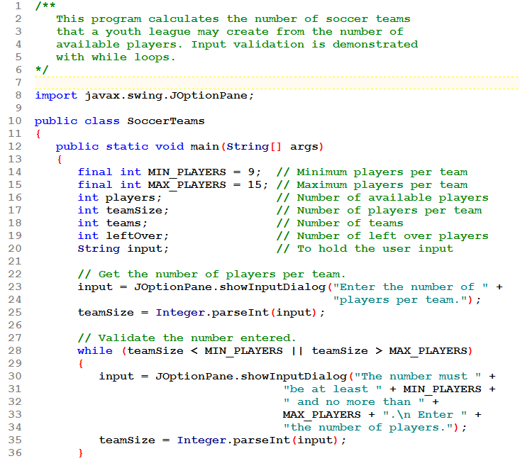
Read teamSize.
Then validate it.

Slide 29
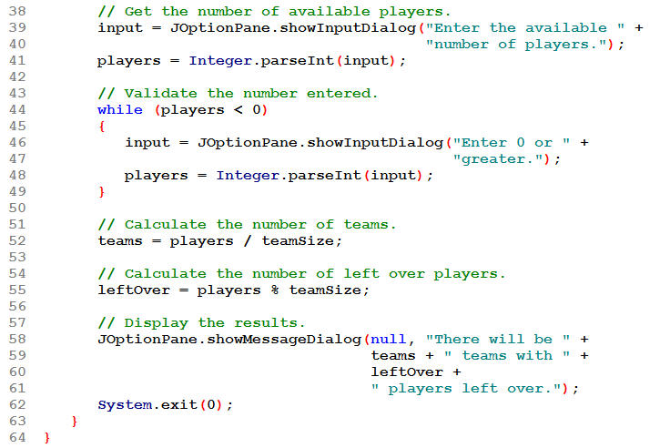
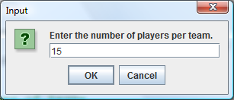
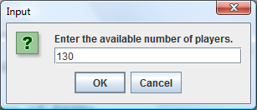
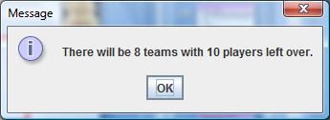
Read players.
Then validate it.

Slide 30
The do-while Loop
Syntax:
  do
  {
  loop body;
  } while( expression );
Semantics:
  Go through the code in the loop body.
  Then evaluate the expression
    If true, do the loop body, then come back to the expression.
    If false, loop is over.
Notes:
Java Gaddis 4e
CHAPTER 4

Slide 31
The do-while Loop
Syntax:
  do
  {
  loop body;
  } while( expression );
More semantics:
  This is a post-test loop. That means the statements in the loop body will always execute at least once.
  Braces are only needed if there is more than one statement in the loop. Recommend you always use them.
Notes:
Java Gaddis 4e
CHAPTER 4

Slide 32
The do-while Loop Flowchart
statement(s)
true
boolean
expression?
false
4-<number>

Slide 33
do-while Example
int x = 1;
do
{
System.out.println(x);
} while(x < 0);
Example of how NOT to use a do-while loop!
Although the test expression is false, this loop will execute one time because do-while is a posttest loop.
Example: TestAverage1.java
1-<number>

Slide 34
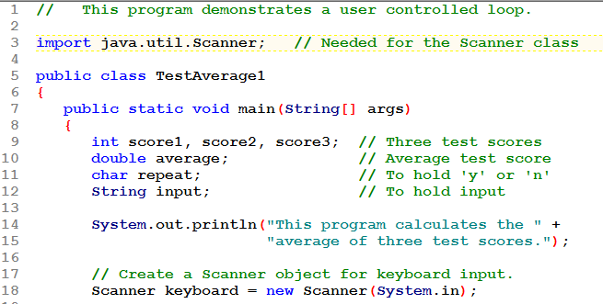
Example of how TO use a do-while loop!
Program will continue to loop, reading 3 scores and calculating their average each time. Loop will end when the user indicates there are not more data to process.

Slide 35
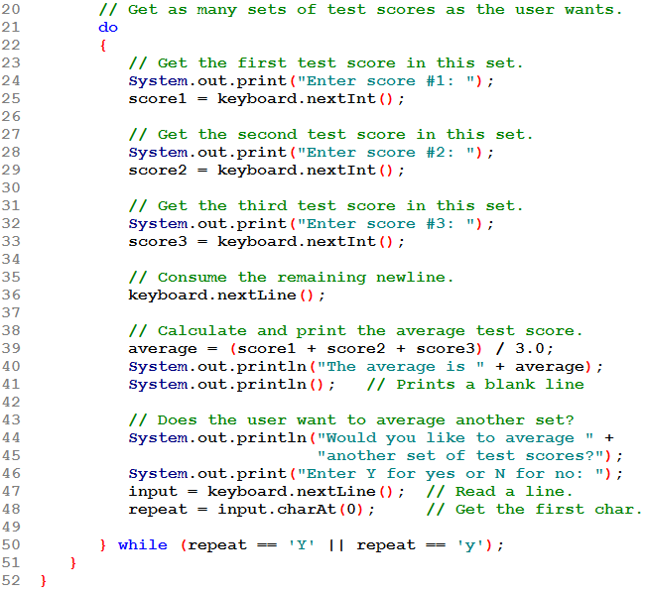
NOTE: Since we read some ints and then want to read a String, we need to remove the newline from the input stream before reading the String!

Slide 36
At the bottom of the loop, find out if there is more data to process.
Note how a char answer is read.

Slide 37
Comparing the while and do-while Loops
Use the while loop when you have to pass some test JUST TO START the loop.
If you want to run through this loop AT LEAST ONCE, then use a do…while instead.
  If you find you are using "brute force" to get into a while loop, then you should re-write it as a do…while loop.
  See the next slides for examples.
Notes:
Java Gaddis 4e
CHAPTER 4

Slide 38
Comparing the while and do-while Loops
"Brute force": initializing repeat to 'y' is done for only one reason: so that you get into the loop!
  char repeat = 'y'; ← this is brute force!
  while (repeat == 'y' || repeat == 'Y')
  {
  // do something
  System.out.print("Again? (y/n): ");
  input = keyboard.nextLine();
  repeat = input.charAt(0);
  }
Notes:
Java Gaddis 4e
CHAPTER 4

Slide 39
Comparing the while and do-while Loops
"Brute force": avoided this time by using do…while.
  char repeat; ← no brute force!
  do
  {
  // do something
  System.out.print("Again? (y/n): ");
  input = keyboard.nextLine();
  repeat = input.charAt(0);
  } while (repeat == 'y' || repeat == 'Y');
Notes:
Java Gaddis 4e
CHAPTER 4

Slide 40
THE for LOOP
Write a loop to read and total 10 numbers
  counted loop using while
  int counter = 0;
  while ( counter < 10 )
  {
  read num;
  total += num;
  counter++;
  }
  Watch the numbered components
1: initialize
2: test
3: loop body
4: Update
Notes:
Java Gaddis 4e
CHAPTER 4

Slide 41
THE for LOOP
Same loop using for syntax:
  for ( int counter = 0; counter < 10; counter++ )
  {
  read num;
  total += num;
  }
Semantics:
  1. initialize section executes
  2. test is performed: false here → loop is over
  3. loop body executes
  4. "update" section executes, then control goes back to test
1: initialize
2: test
4: update
3: loop body
Notes:
Java Gaddis 4e
CHAPTER 4

Slide 42
THE for LOOP
Same loop using for syntax:
  for ( int counter = 0; counter < 10; counter++ )
  {
  read num;
  total += num;
  }
More Semantics:
  This is a pre-test loop: it will be skipped if the test is initially false.
  A variable declared inside the for ( ) can only be used in this loop (counter in this example). Its scope does not extend beyond it.
1: initialize
2: test
4: update
3: loop body
Notes:
Java Gaddis 4e
CHAPTER 4

Slide 43
The for Loop Flowchart
initialize control
variable
boolean
expression?
true
statement(s)
update
false
4-<number>

Slide 44
The for Loop
Example: Squares.java
Example: UserSquares.java
4-<number>
Notes:
CHAPTER 4
Java Gaddis 4e

Slide 45
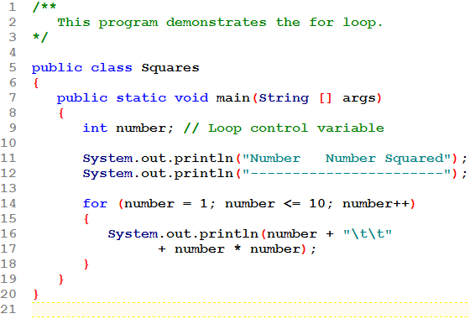
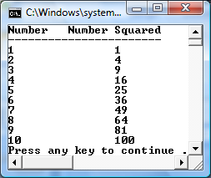

Slide 46
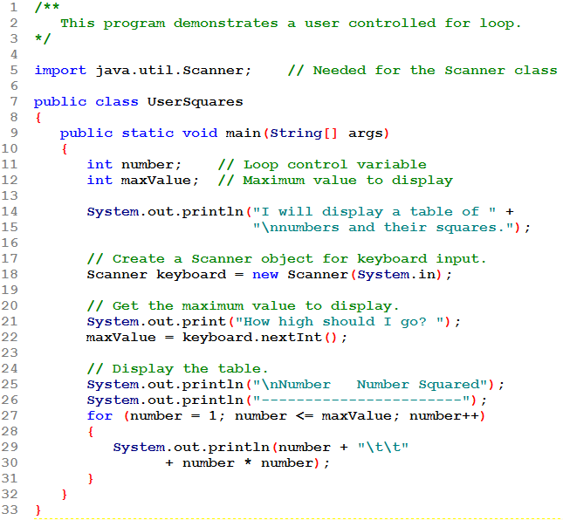
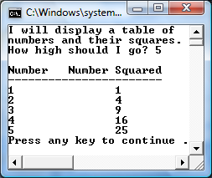

Slide 47
When to Use the for Loop
In any situation that clearly requires:
  an initialization
  a false condition to stop the loop
  an update to occur at the end of each iteration
1-<number>

Slide 48
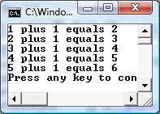
for Loop - Modifications
You can have multiple statements in the initialization expression. Separate the statements with a comma:
int x, y;
for (x=1, y=1; x <= 5; x++)
{
System.out.println(x + " plus "
+ y + " equals " + (x+y));
}
Initialization Expression
1-<number>
Notes:
CHAPTER 4
Java Gaddis 4e

Slide 49
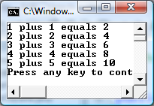
for Loop - Modifications
You can also have multiple statements in the update expression. Separate the statements with a comma:
int x, y;
for (x=1, y=1; x <= 5; x++, y++)
{
System.out.println(x + " plus "
+ y + " equals " + (x+y));
}
Update Expression
1-<number>
Notes:
CHAPTER 4
Java Gaddis 4e

Slide 50
THE for LOOP
Example 1: Sum the numbers from 1 to 100 using a for loop
Notes:
Java Gaddis 4e
CHAPTER 4

Slide 51
THE for LOOP
Example 1: Sum the numbers from 1 to 100 using a for loop
  int sum = 0;
  for ( int num = 1; num <= 100; num++ )
  {
  sum += num;
  }
  // display sum
Initialize sum to 0 before the loop
set num to 1
test that num is less or equal to 100
loop body: add num to sum
add 1 to num, then back to test
Notes:
Java Gaddis 4e
CHAPTER 4

Slide 52
THE for LOOP
Example 2: Sum the ODD numbers from 1 to 100 using a for loop
Notes:
Java Gaddis 4e
CHAPTER 4

Slide 53
THE for LOOP
Example 2: Sum the ODD numbers from 1 to 100 using a for loop
  int sum = 0;
  for ( int num = 1; num <= 100; num += 2 )
  {
  sum += num;
  }
  // display sum
The "update" part can contain any expression you want. Generally, it is an expression that changes the value of the loop control variable.
Notes:
Java Gaddis 4e
CHAPTER 4

Slide 54
THE for LOOP
Example 3: Write a for loop that displays this sequence of numbers: 10, 5, 0, -5, -10
Notes:
Java Gaddis 4e
CHAPTER 4

Slide 55
THE for LOOP
Example 3: Write a for loop that displays this sequence of numbers: 10, 5, 0, -5, -10
  for ( int num = 10; num >= -10; num -= 5 )
  {
  // display num
  }
Start num at 10
Test that it is greater or equal to -10
Display num
Subtract 5 from num, then back to test
Notes:
Java Gaddis 4e
CHAPTER 4

Slide 56
Modifying The Control Variable
You should avoid updating the control variable of a for loop within the body of the loop.
The update section should be used to update the control variable.
Updating the control variable in the for loop body leads to hard to maintain code and difficult debugging.
4-<number>
Notes:
CHAPTER 4
Java Gaddis 4e

Slide 57
THE for LOOP
None of the 3 areas on the loop header is required:
    for ( ; ; )
    {
    loop body
    }
  first part is empty if no initialization is needed
  if middle is empty, Java presumes the test is true and we have an infinite loop (Recall that the loop ends when the test is false. If there isn't any test, then it can't be false!)
  last part is empty if not needed
  the 2 semicolons are always required
Notes:
Java Gaddis 4e
CHAPTER 4

Slide 58
Keeping a Running Total
Programs that calculate the total of a series of numbers typically use:
  A loop that reads each number in the series.
  A variable that accumulates the total of the numbers as they are read.
1-<number>
Notes:
CHAPTER 4
Java Gaddis 4e

Slide 59
Keeping a Running Total
running total: accumulated sum of numbers from each repetition of loop
  the loop is said to "accumulate a running total"
accumulator: variable that holds running total
  usually initialized to 0
  its type should be proper for the data being summed: int or double as appropriate.
Example: TotalSales.java
1-<number>
Notes:
CHAPTER 4
Java Gaddis 4e

Slide 60
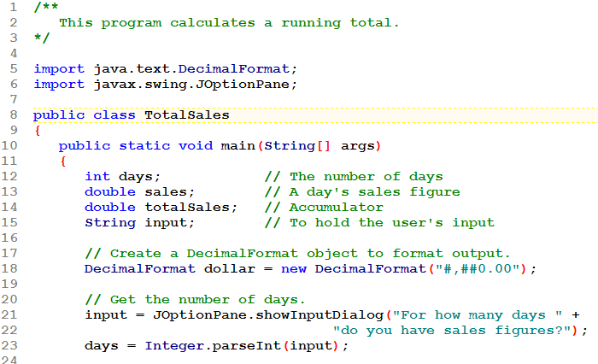
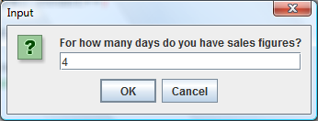

Slide 61
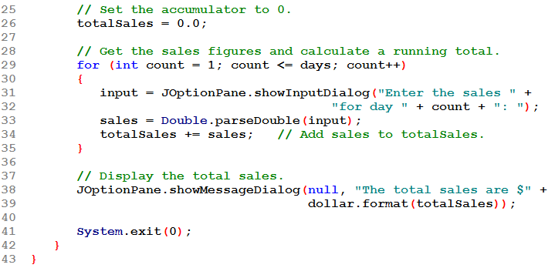
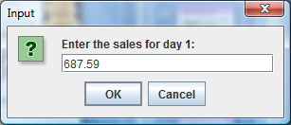
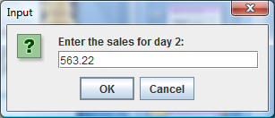
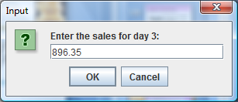

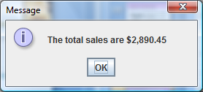

Slide 62
Sentinel Values
Sometimes the end point of input data is not known.
A sentinel value can be used to notify the program to stop acquiring input.
If it is a user input, the user could be prompted to input data that is not normally in the input data range (i.e. –1 where normal input would be positive.)
Programs that get file input typically use the end-of-file marker to stop acquiring input data.
Example: SoccerPoints.java
4-<number>
Notes:
CHAPTER 4
Java Gaddis 4e

Slide 63
Priming-Read Organization
This organization is often referred to a "PRIMING-READ ORGANIZATION."
The pseudo-code for priming-read org:
Prompt and read the first value
While the value is not the sentinel
Process the value
Prompt and read the next value
End while
1-<number>
Notes:
CHAPTER 4
Java Gaddis 4e

Slide 64
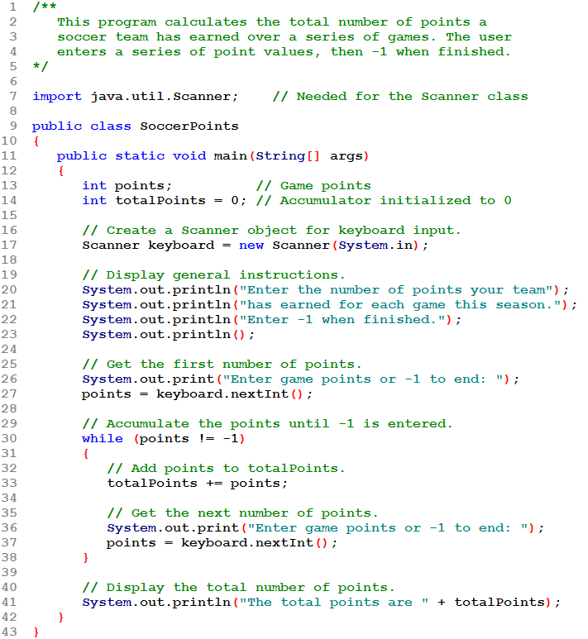
Set up the Priming-Read Organization.
User will enter -1 as a sentinel.

Slide 65
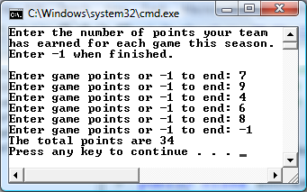
priming read
process
read again
Prompt and read first value before the loop.
Inside the loop, process the value.
At the bottom of the loop, prompt and read the next value.

Slide 66
Combining a Sentinel with Input Validation
Problem: I want to find the average of several quiz scores.
  I don't know how many scores
  I need to validate the score as it's being read.
This combines
  Using a sentinel-controlled loop to read the quiz scores
  Embedding code in the loop to ensure only valid scores are accepted.
1-<number>

Slide 67
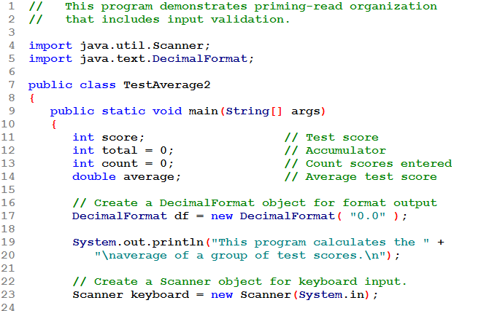

Slide 68
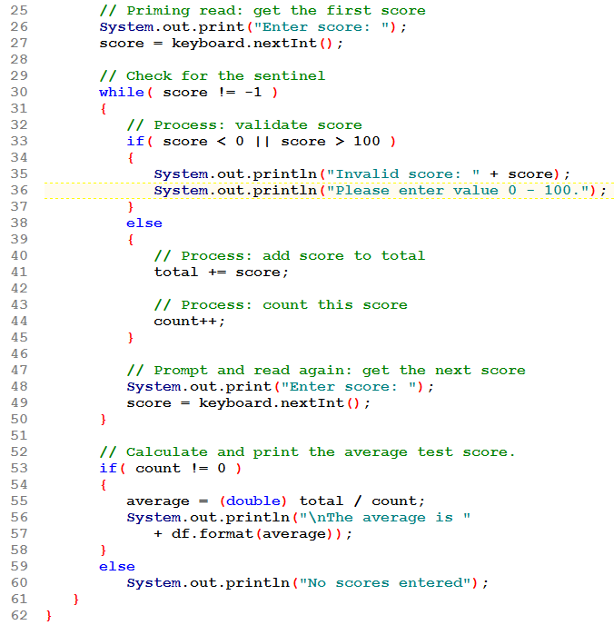
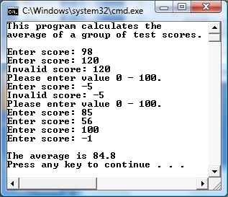
priming read
See next slide for
more about the logic
used here.
process
read again

Slide 69
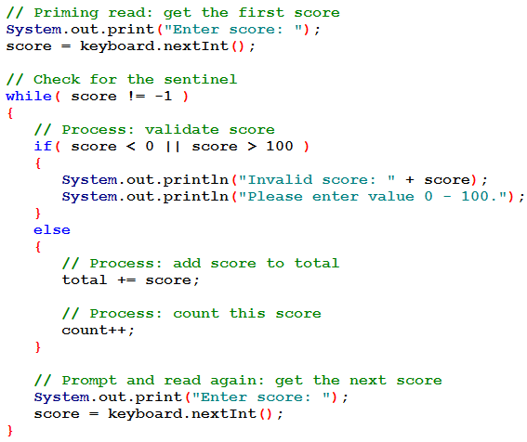
The validation logic:
If you get into the loop you KNOW it's not the sentinel
So inside the loop, do a range check on the value. No need to look for the sentinel here!
If the value is bad, say so
If the value is good, process it
Read the next value at the bottom of the loop – NOTICE this is not inside the if/else statement. Whether the value being processed is good or bad, you need to read a new value. So do that outside of (i.e. after) the if/else statement.
1
2
3
4
5

Slide 70
Nested Loops
Like if statements, loops can be nested.
If a loop is nested, the inner loop will execute all of its iterations for each time the outer loop executes once.
  for(int i = 0; i <= 3; i++) // outer loop
    for(int j = 0; j <= 3; j++) // inner loop
      System.out.println( i * j );
The loop statements in this example will execute 16 times.
Example: Clock.java
4-<number>
Notes:
CHAPTER 4
Java Gaddis 4e

Slide 71

Nested Loops
Consider a digital clock: 11:04:36
Could we write a program to simulate its display?
Start with a loop to display all the seconds:
What about the leading 0's?
1-<number>
Notes:
CHAPTER 4
Java Gaddis 4e

Slide 72
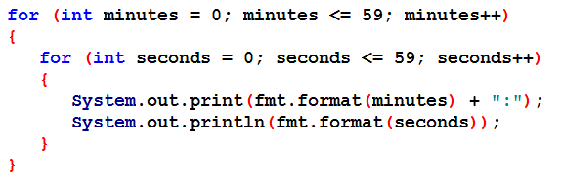
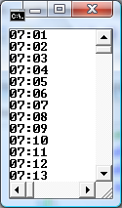
Nested Loops
Let's get the minutes next:
Hours work in a similar way.
See the completed program on the
next slide.
1-<number>
Notes:
CHAPTER 4
Java Gaddis 4e

Slide 73
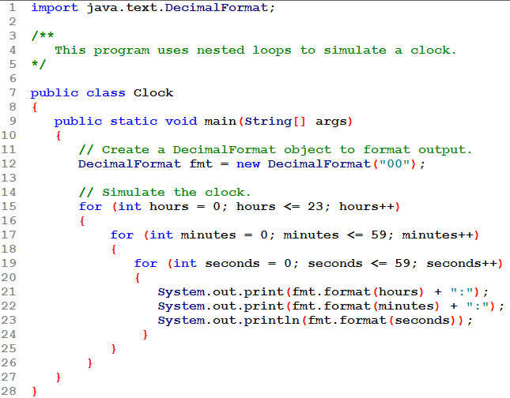
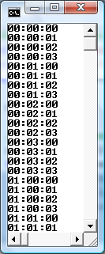
The output is abbreviated! How many lines would it produce?
24 x 60 x 60 = 86,400!
Be careful with nested loops. Know what you are asking for!

Slide 74
The break Statement
The break statement can be used to abnormally terminate a loop.
The use of the break statement in loops bypasses the normal mechanisms and makes the code hard to read and maintain.
It is considered bad form to use the break statement in this manner.
**** Use of a break (except within a switch) in any program done for this class will result in a 10% deduction!
4-<number>
Notes:
CHAPTER 4
Java Gaddis 4e

Slide 75
The continue Statement
The continue statement will cause the currently executing iteration of a loop to terminate and the next iteration will begin.
The continue statement will cause the evaluation of the condition in while and for loops.
Like the break statement, the continue statement should be avoided because it makes the code hard to read and debug.
**** Use of a continue in any program done for this class will result in a 10% deduction!
4-<number>
Notes:
CHAPTER 4
Java Gaddis 4e

Slide 76
File Input and Output
Reentering data all the time could get tedious for the user.
The data can be saved to a file.
  Files can be input files or output files.
Files:
  Files have to be opened.
    You should always check that this was successful
  Data is then read from or written to the file.
  The file must be closed prior to program termination.
In general, there are two types of files:
  text, which we are covering here
  binary, covered later in the book, not in this course
4-<number>
Notes:
CHAPTER 4
Java Gaddis 4e

Slide 77
Writing Text To a File: OPEN the file
To open a file for text output you create an instance of the PrintWriter class.
PrintWriter outputFile =
new PrintWriter("StudentData.txt");
Pass the name of the file that you wish to open as an argument to the PrintWriter constructor.
Warning: if the file already exists, it will be erased and replaced with a new file.
4-<number>
Notes:
CHAPTER 4
Java Gaddis 4e

Slide 78
The PrintWriter Class: WRITE to it
The PrintWriter class allows you to write data to a file using the print and println methods, as you have been using to display data on the screen.
Just as with the System.out object, the println method of the PrintWriter class will place a newline character after the written data.
The print method writes data without writing the newline character.
4-<number>
Notes:
CHAPTER 4
Java Gaddis 4e

Slide 79
The PrintWriter Class: CLOSE the file
To close the file, use the PrintWriter class's close method:
PrintWriter outputFile =
new PrintWriter("StudentData.txt");
...
outputFile.close();
4-<number>
Notes:
CHAPTER 4
Java Gaddis 4e

Slide 80
The PrintWriter Class
Open the file.
PrintWriter outputFile = new PrintWriter("Names.txt");
outputFile.println("Chris");
outputFile.println("Kathryn");
outputFile.println("Jean");
outputFile.close();
Close the file.
Write data to the file.
4-<number>
Notes:
CHAPTER 4
Java Gaddis 4e

Slide 81
The PrintWriter Class
To use the PrintWriter class, put the following import statement at the top of the source file:
import java.io.*;
4-<number>
Notes:
CHAPTER 4
Java Gaddis 4e

Slide 82
Exceptions
When something unexpected happens in a Java program, an exception is thrown.
The method that is executing when the exception is thrown must either handle the exception or pass it "up the line".
Handling the exception will be discussed later.
To pass it up the line, the method needs a throws clause in the method header.
4-<number>
Notes:
CHAPTER 4
Java Gaddis 4e

Slide 83
Exceptions
To insert a throws clause in a method header, simply add the word throws and the name of the expected exception.
PrintWriter objects can throw an IOException, so we write the throws clause like this:
  public static void main(String[] args) throws IOException
See example: FileWriteDemo.java
4-<number>
Notes:
CHAPTER 4
Java Gaddis 4e

Slide 84
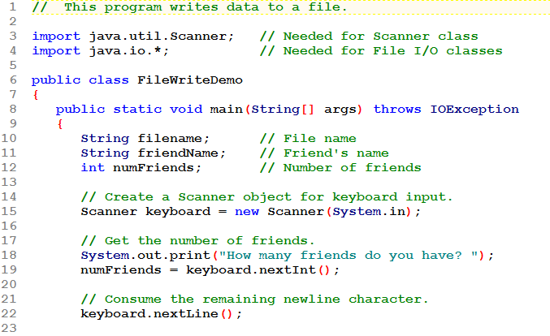
Remember, that if you must follow the reading of a numeric value with the reading of a String (using nextLine()), you must remove the newline from the input stream before reading the String.

Slide 85
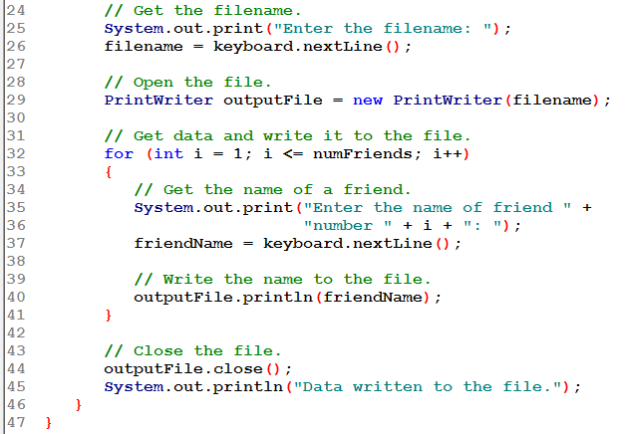
This is still using keyboard input
Open the file (using a String variable in this example)
Write the data to the file
Close the file

Slide 86
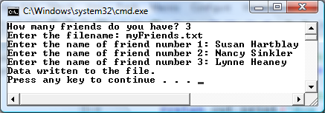
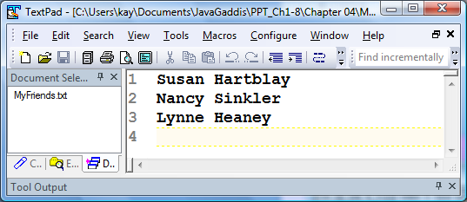
The system console while data is being input and stored in the file.
The file (myFriends .txt) is opened within Textpad. Three names have been written to the file.

Slide 87
Appending Text to a File
To avoid erasing a file that already exists, create a FileWriter object in this manner:
FileWriter fw =
new FileWriter("names.txt", true);
Then, create a PrintWriter object in this manner:
PrintWriter outputFile = new PrintWriter(fw);
See example: FileAppendDemo.java
4-<number>
Notes:
CHAPTER 4
Java Gaddis 4e

Slide 88
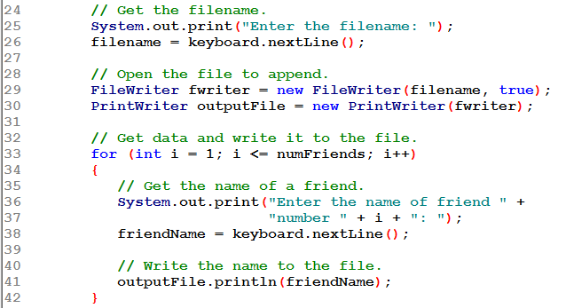
The only change is to open the file for appending.

Slide 89
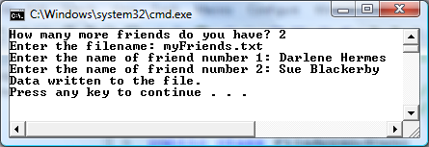
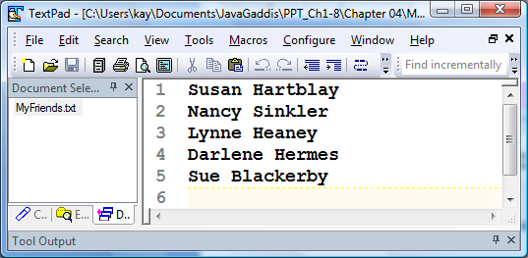
The system console while data is being input and stored in the file.
The file (myFriends .txt) is opened within Textpad. Two names have been appended.

Slide 90
Specifying a File Location
On a Windows computer, paths contain backslash (\) characters.
Remember, if the backslash is used in a string literal, it is the escape character so you must use two of them:
  PrintWriter outFile =
  new PrintWriter("C:\\PriceList.txt");
4-<number>
Notes:
CHAPTER 4
Java Gaddis 4e

Slide 91
Specifying a File Location
This is only necessary if the backslash is in a string literal.
If the user enters a filename to be stored in a String object then the user does not have to enter double backslashes.
NOTE: Java allows you to use the slash (/) instead of the backslash (\) in Windows pathnames. If you do so, the need to use double backslashes is eliminated.
4-<number>
Notes:
CHAPTER 4
Java Gaddis 4e

Slide 92
Reading Data From a File: OPEN the file
You use the File class and the Scanner class to read data from a file:
Pass the name of the file as an argument to the File class constructor.
File myFile = new File("Customers.txt");
Scanner inputFile = new Scanner(myFile);
Pass the File object as an argument to the Scanner class constructor.
4-<number>
Notes:
CHAPTER 4
Java Gaddis 4e

Slide 93
Reading Data From a File: OPEN the file
  Scanner keyboard = new Scanner(System.in);
  System.out.print("Enter the filename: ");
  String filename = keyboard.nextLine();
  File theFile = new File(filename);
  Scanner inputFile = new Scanner(theFile);
The lines above:
  Creates an instance of the Scanner class to read from the keyboard
  Prompt the user for a filename
  Get the filename from the user
  Create an instance of the File class to represent the file
  Create an instance of the Scanner class that reads from the file
4-<number>
Notes:
CHAPTER 4
Java Gaddis 4e

Slide 94
Reading Data From a File: READ from it and CLOSE the file
Once an instance of Scanner is created, data can be read using the same methods that you have used to read keyboard input (nextLine, nextInt, nextDouble, etc).
  // Open the file.
  File file = new File("Names.txt");
  Scanner inputFile = new Scanner(file);
  // Read a line from the file.
  String str = inputFile.nextLine();
  // Close the file.
  inputFile.close();
4-<number>
Notes:
CHAPTER 4
Java Gaddis 4e

Slide 95
Exceptions
The Scanner class can throw an IOException when a File object is passed to its constructor.
So, we put a throws IOException clause in the header of the method that instantiates the Scanner class.
See Example: ReadFirstLine.java
4-<number>
Notes:
CHAPTER 4
Java Gaddis 4e

Slide 96
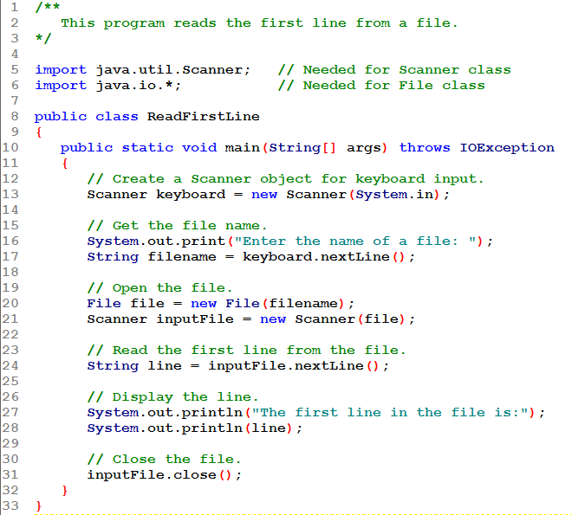
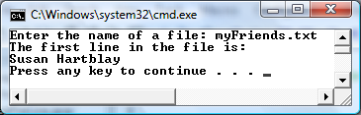
There are two Scanner objects here:
keyboard to read from the keyboard
inputFile to read from the file

Slide 97
Detecting the End of a File
It's usually the case that a file you are opening for input contains an unknown amount of data: it might even be empty.
Java provides a method, hasNext(), within the Scanner class that can be used to determine if a file has more data in it or not.
The Scanner class’s hasNext()method will return true if another item can be read from the file, false otherwise.
4-<number>
Notes:
CHAPTER 4
Java Gaddis 4e

Slide 98
Detecting the End of a File
Use this to implement looping to read data from a file:
  It must deal properly with an empty file
  It must stop looping (i.e. stop reading) when the entire file has been processed.
While there is more data
Read the next value
Process the value
End while
4-<number>
Notes:
CHAPTER 4
Java Gaddis 4e

Slide 99
Detecting the End of a File
  // Open the file.
  File file = new File(filename);
  Scanner inputFile = new Scanner(file);
  // Read until the end of the file.
  while (inputFile.hasNext())
  {
  String str = inputFile.nextLine();
  System.out.println(str);
  }
  inputFile.close();// close the file when done.
See example: FileReadDemo.java
4-<number>
Notes:
CHAPTER 4
Java Gaddis 4e

Slide 100
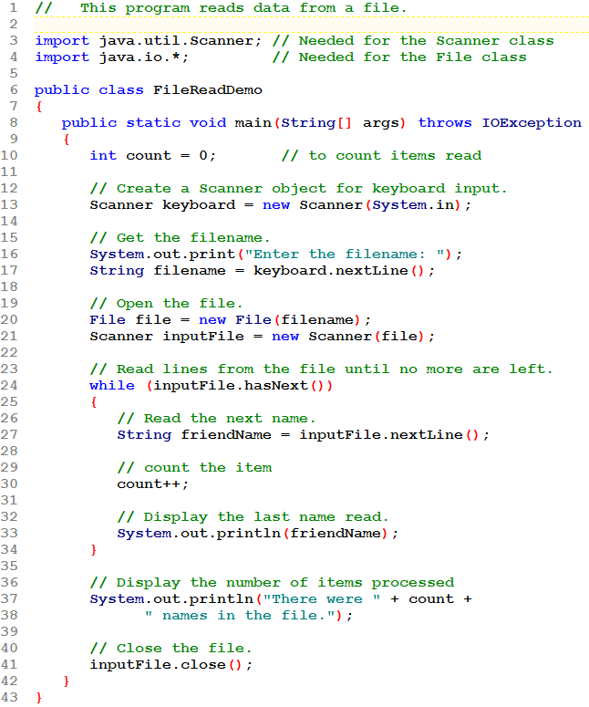
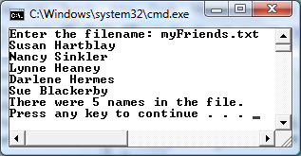
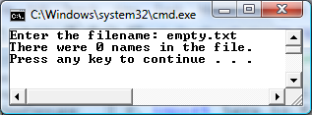
The hasNext() method does a "look ahead" to see if the file has more data or not.

Slide 101
Checking for an Input File's Existence
A program that reads data should always check that the file exists before actually opening it for reading.
  If it is opened for input but doesn't exist and exception will be thrown and the program will likely end without giving the user an "English" error message.
The File class's exists method can be used for this purpose.
Example: FileSum2.java
4-<number>
Notes:
CHAPTER 4
Java Gaddis 4e

Slide 102
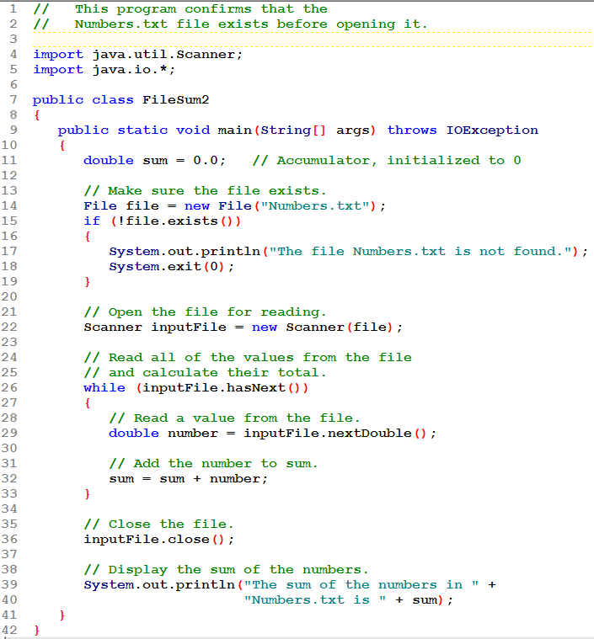
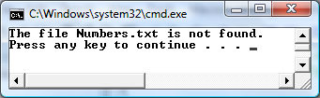
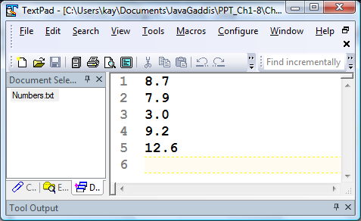
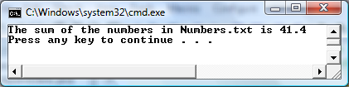
Above, the file had not been created.
Below, it had been created and was processed.

Slide 103
Checking for an Output File's Existence
A program that writes data will erase the file if it already exists. Although this is often the desired situation, there are times it is important to be sure NOT to erase an existing file.
  Especially when a user will be entering a file name and might unknowingly enter the name of an existing file.
The File class's exists method can also be used for this purpose.
Example: FileWriteDemo2.java
4-<number>
Notes:
CHAPTER 4
Java Gaddis 4e

Slide 104
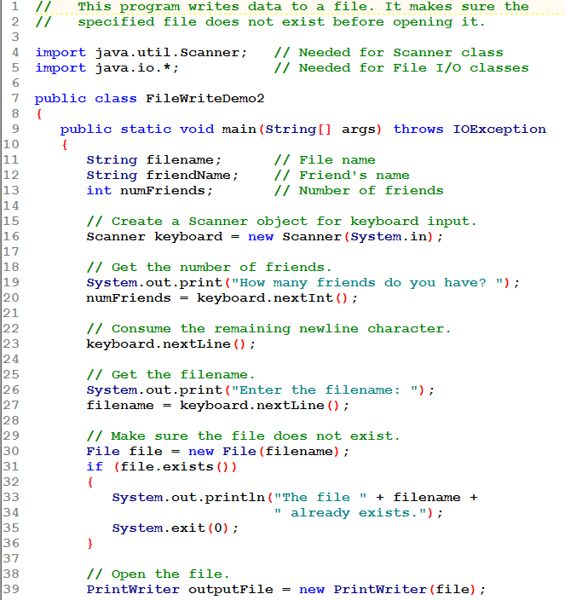
If the file already exists, display an error message and stop the program.
See earlier FileWriteDemo.java for the rest of the program.

Slide 105
The Random Class
Some applications, such as games and simulations, require the use of randomly generated numbers.
The Java API has a class, Random, for this purpose. To use the Random class, use the following import statement and create an instance of the class.
  import java.util.Random;
  Random randomNumbers = new Random();
You only need one Random object in a program. Generate as many random numbers as you need using that one object.
4-<number>
Notes:
CHAPTER 4
Java Gaddis 4e

Slide 106
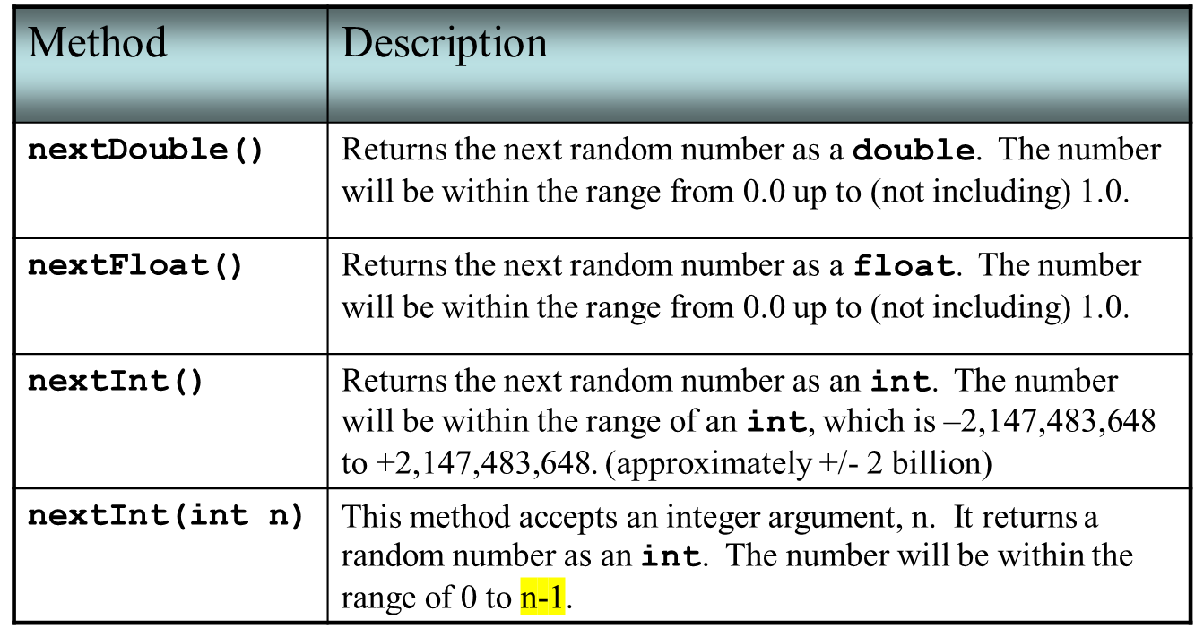
Some Methods of the
Random Class
See example: MathTutor.java
Text says the range is 0 to n, but in fact it is 0 to n-1!
4-<number>
Notes:
CHAPTER 4
Java Gaddis 4e

Slide 107
The Random Class
EXAMPLES
To generate an int (+/- 2 billion)
  int x1 = randomNumbers.nextInt();
To generate an int in the range 0 - 9
  int x2 = randomNumbers.nextInt(10);
  The argument indicates the number of values in the range, which is 10 in this case
  Range will start at 0 and end at 10 – 1 → 9
4-<number>
Notes:
CHAPTER 4
Java Gaddis 4e

Slide 108
The Random Class
EXAMPLES:
To generate an int in the range 1 - 10
  int x3 = randomNumbers.nextInt(10) + 1;
  Add a value to "shift" the range to a new starting point
To generate an int in the range 5 - 10
  int x4 = randomNumbers.nextInt(6) + 5;
  There are 6 numbers in the range (0 – 5)
  Adding 5 shifts the numbers to the range 5 - 10
4-<number>
Notes:
CHAPTER 4
Java Gaddis 4e

Slide 109






RANGE: +/- 2 billion
RANGE: 0 - 9
RANGE: 5 - 10

Slide 110
The Random Class
EXAMPLES:
To generate a double
  double d1 = randomNumbers.nextDouble();
  This will be a value, such that 0 <= d1 < 1.0
To expand the range of the random double, multiply by a factor
  double d2 = 5 * randomNumbers.nextDouble();
  This will be a value, such that 0 <= d2 < 5.0
4-<number>
Notes:
CHAPTER 4
Java Gaddis 4e

Slide 111
The Random Class
EXAMPLES:
To shift the range of the random double, add something
  double d3 = randomNumbers.nextDouble() + 2.5;
  This will be a value, such that 2.5 <= d3 < 3.5
Combine these for even more control over the random double
  double d4 = 5 * randomNumbers.nextDouble() + 2.5;
  This will be a value, such that 2.5 <= d4 < 7.5
4-<number>
Notes:
CHAPTER 4
Java Gaddis 4e

Slide 112






RANGE:
0.0 <= x < 1.0
RANGE:
0.0 <= x < 5.0
RANGE:
2.5 <= x < 7.5

Slide 113



RANGE: 0 – 99
Only one Random object is needed.

Slide 114
END CHAPTER 4

